Slide 1
Building a Model for Teacher Leadership
Jake Madden

Slide 2
Presentation Outline
Set the scene
School Improvement/Reform Practices
Introduce the CTLM
Identify Key mechanisms for fostering TL
Answer any questions

Slide 3
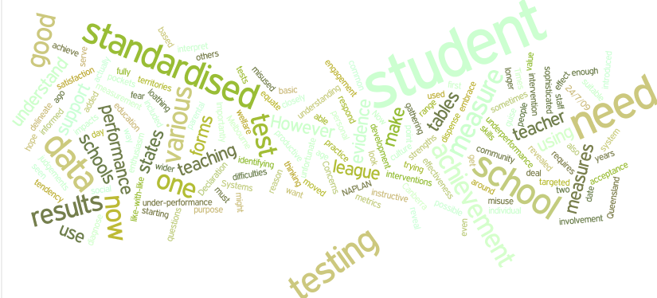
Notes:
Scrutiny on Education and school performances

Slide 4
Educational Clutter – Silver Bullets
Focus on pedagogical innovations
External Accountabilities
Professional Learning Communities
21st Century Skills Sets
Flipped Classrooms
Self Regulated Platforms (learning 24/7)
Personalised Learning
Flexible Learning Spaces
Project Based Learning
Innovative Schools
International Benchmarking (PISA, TIMSS)
School Inspections
School Accreditations
Community Expectations
Notes:
How does a school come to terms with the many expectations

Slide 5
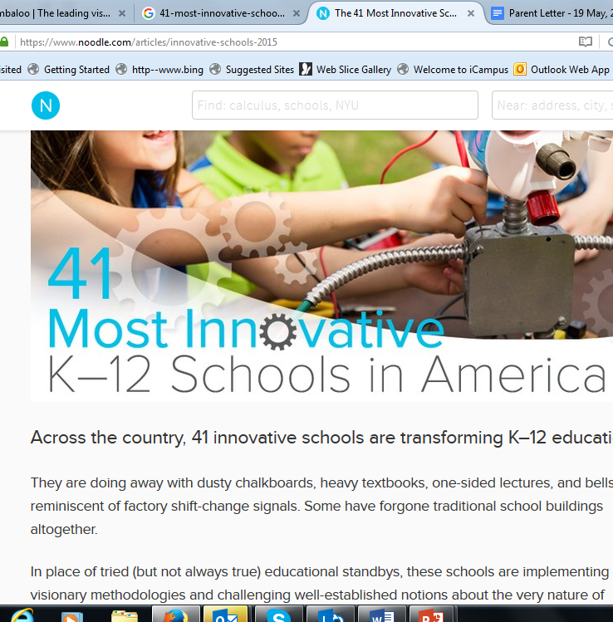
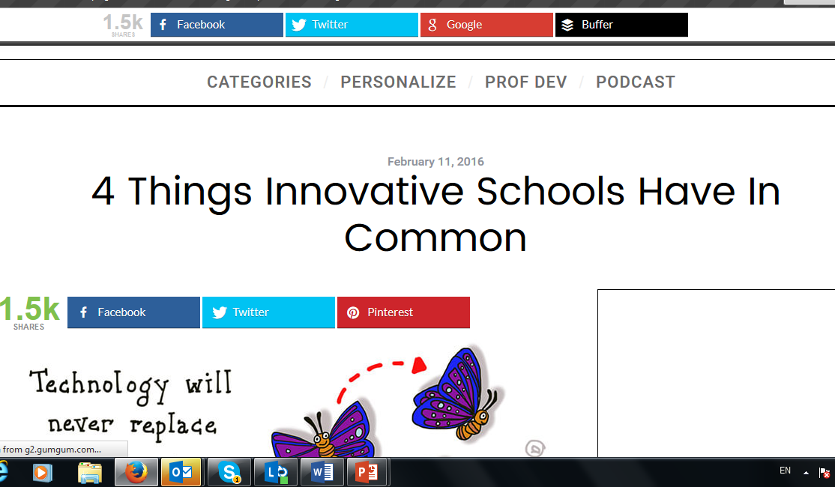
Notes:
students are seen as unique individuals rather than groups
schools are connected with the outside world
curriculum is delivered in a manner that encourages critical and creative thinking
design of the learning spaces is creative

Slide 6
Why Educational Change Often Fails?
A lack of ownership by staff and a deficiency of understanding why improvement is Needed
Not understanding how the change is expected to be implemented,
The pace of change is poorly managed,
The change is mandated from the hierarchy, and
The key leaders in the school lack commitment to the change.

Slide 7
How to Create an Effective School!
A unified vision and mission dedicated on teaching and learning;
A strong professional community based on collaborative work and collective responsibility for student learning;
Instructional leadership led by the Principal
Sufficient resources particularly human, material, instructional, fiscal;
Timely, accessible and accurate data about students and learning;
Well qualified instructional staff;
Significant professional learning opportunities;
Community support
Notes:
We know what makes an effective school…… but how do we get there

Slide 8
The teacher, not the school, makes the difference
John Hattie, Visible Learning
Notes:
So what do we do to improve teacher practice?

Slide 9
REVIEW AND META-ANALYSES OF SCHOOL AND TEACHING EFFECTIVENESS
Quality Teacher Studies
FACTORS CONTRIBUTING TO TEACHING SUCCESS
Teachers genuinely expert in their subject area(s), and enjoyed teaching
Three sorts of knowledge essential:
Subject content knowledge (what subject content to teach)
Subject pedagogic knowledge (how to teach particular subject content)
Subject course knowledge (subject curriculum, assessment, exam knowledge)
School Background
Subject Faculty
Personal Qualities
Relationships With Students
Professional Development
Resources and Planning
Teaching Strategies

Slide 11
Teacher leadership is the process by which teachers, individually or collectively, influence their colleagues, principals, and other members of school communities to improve teaching and learning practices with the aim of increased student learning and achievement.
York-Barr & Duke, 2004
Its all about influence

Slide 12
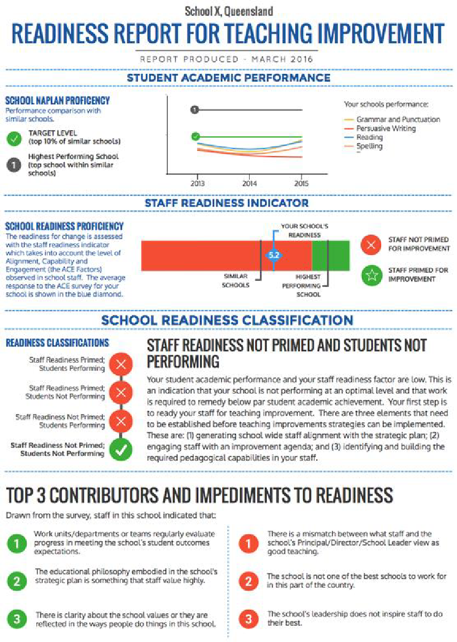
School readiness for reform
Student Academic Performance
Staff Readiness Indicators
School Readiness Ratings
Identified Impediments and Contributors to Readiness
Notes:
Need Photo of readiness form

Slide 13
School readiness for reform
Alignment
Capability
Engagement
Notes:
Need Photo of readiness form

Slide 14
Building A Model for Teacher Leadership
Building a Desire to Change
Building Teacher Capacity
Job Embedded Professional Learning
Teacher Leadership

Slide 15
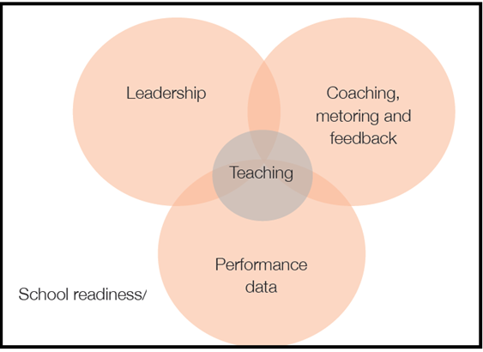
Contemporary Teacher Learning Model
Notes:
Add CTLM Diagram

Slide 16
Practical Implementation
Begin with the school context & then build a vision for learning
Focus on capacity building
Provide Collaborative Time
Establish a data mindset to monitor effective practices
Create a Coaching, Mentoring, Feedback regime
Build a teacher as researcher culture

Slide 17
Essential Take Aways
Quality teaching matters.
Leadership is the big enabler.
Professional Learning is essential.
The best classrooms, departments, schools, and systems have a central focus on students as learners.
The best educational leaders have a focus on teachers as learners.

Slide 18
Thank You
Jake Madden
https://www.researchgate.net/profile/Jake_Madden
https://scu-au.academia.edu/JakeMadden
https://jakemaddenindubai.wordpress.com/

